Slide 1
IST 707
Project Report:
Food Desert Atlas
Miranda Braman
Kaitlyn Keebaugh
Matthew Pergolski
Victor Yamaykin

Slide 2
Introduction
USDA defines food deserts as low-income and low-access areas:
Low-income:
A poverty rate of 20% or more
A median family income at or below 80% of the statewide or urban area median family income
Low-access:
At least 500 people and/or at least 33% of the population lives more than 1 mile from a large grocery store
10 miles, in the case of rural areas

Slide 3
Problem Statement
USDA has labeled data for 2006, but not for 2010, 2015, and 2019
Can classification help to see where food deserts are located?
Help to prevent community health problems
e.g. heart disease, stroke, Type 2 diabetes, high blood pressure, and cancer

Slide 4
Data
Determining data types for all variables
State and County
Population
Occupied Housing Units (OHU)
If people live in an urban area
If they live in a low income area
Poverty rate
The median family income in the community
If it is a food desert or not

Slide 5
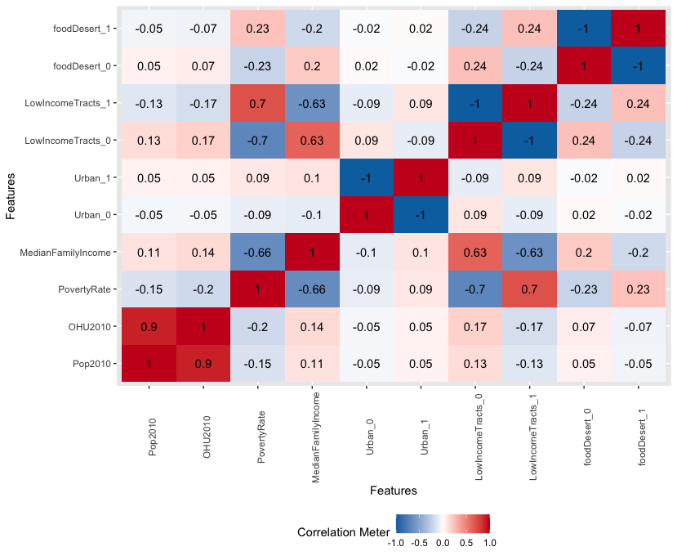
EDA
Correlation Matrix
Food deserts have strong links to:
Low Income Areas
High Poverty Rate

Slide 6
Analysis and Models
Association Rule Mining
‘apriori’
Clustering
‘hclust’
‘agnes’
‘Kmeans’
Decision Tree Classification
Neural Network
KNN
Random Forest

Slide 7
Association Rule Mining
Used oversampling to get a more balanced data set
Discretization of Population, Housing, Poverty Rate, and Median Family Income
Converted the dataframe to transactions
Used the “apriori” algorithm and set right hand side to “foodDesert=1”
Sorted the rules by lift and confidence and support
Best results with
support = 0.25
confidence = 0.7
minlen = 3

Slide 8
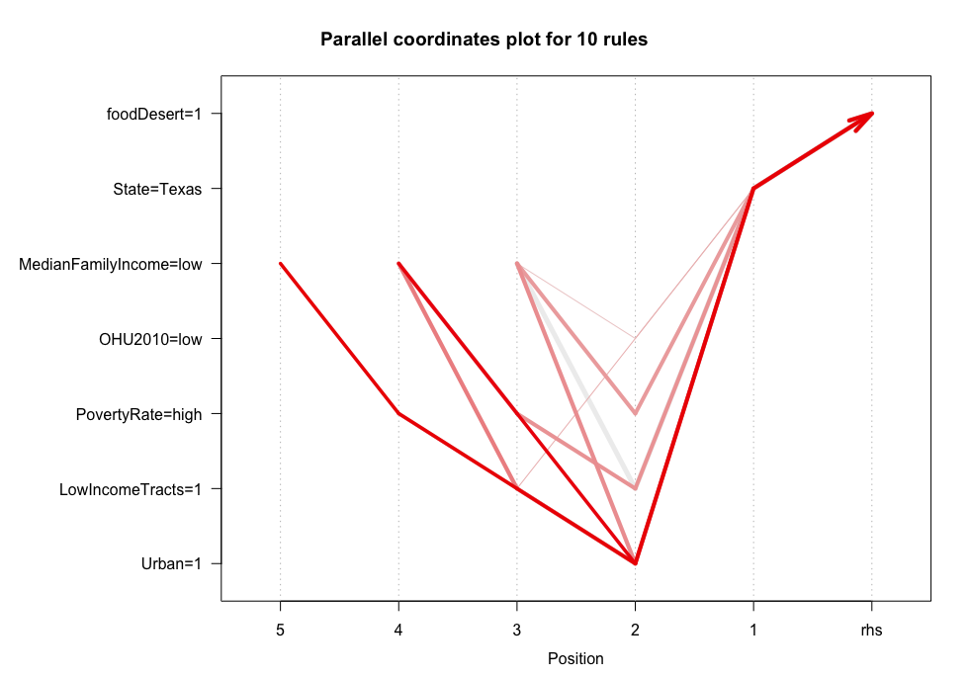

Slide 9
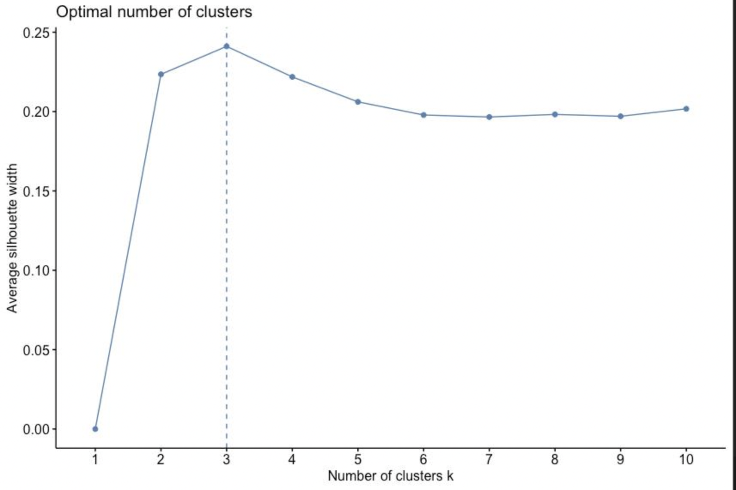
Clustering | General
Unsupervised Learning
Formation of Sub-Groups
Types
K-Means
Hierarchical
Our Data
Numeric Types Only
Useful packages:
tidyverse
cluster
factoextra
Aggregation
Group Data by state
No. of Cluster Chosen
‘Average Silhouette’

Slide 10
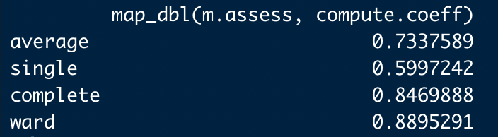
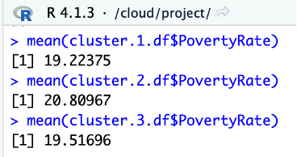
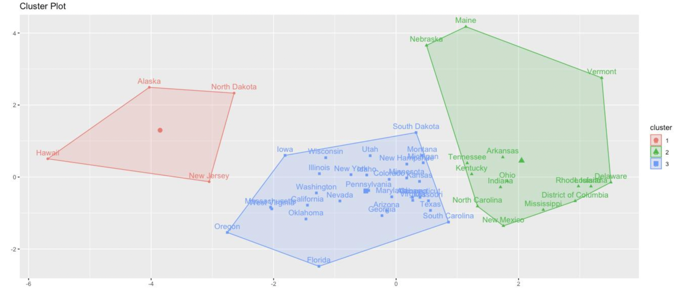
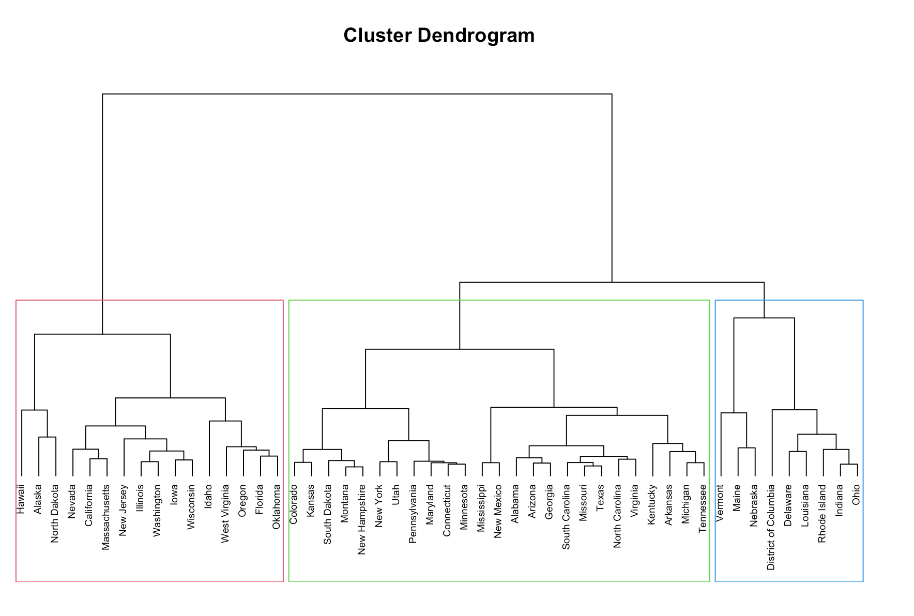
Clustering | K-Means | Hierarchical

Slide 11
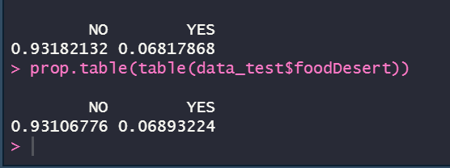
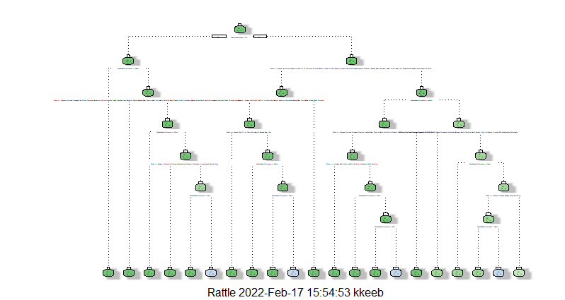
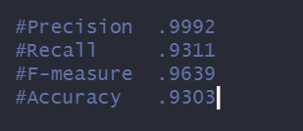
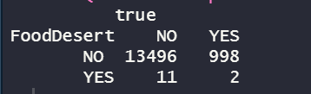
Decision Trees
Notes:
Used the 80/20 method to divide the dataset into a test and train set- Used prop.table to make sure the process worked and each set had roughly the same percentages for being a food desert or not
Limitations: Very large dataset, had to use maxdepth to see a smaller tree
Looked at Median Family Income, Low Income Tract, and State
Had a max depth level of 7
Set seed 341
Very high accuracy
Precision is a/(a+c)
Recall is a/(a+b)
F-measure is 2*precision * recall/ (precision + recall)
Accuracy is a+d/(a+b+c+d

Slide 12
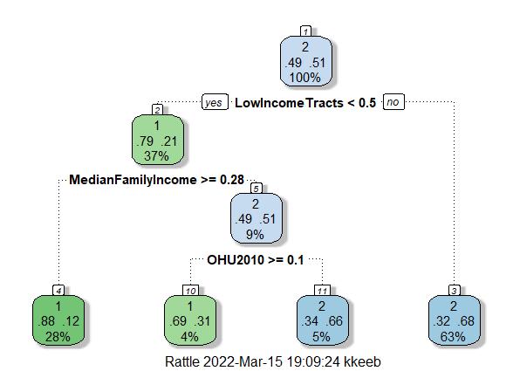
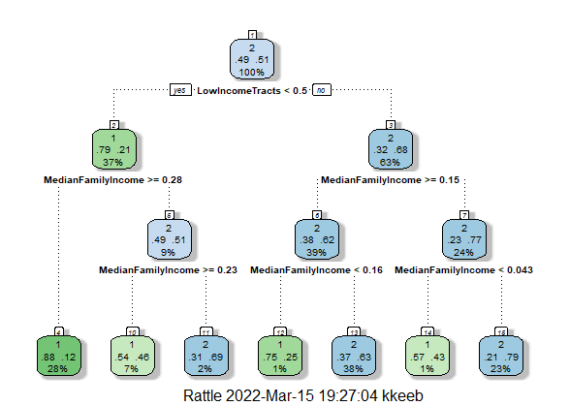
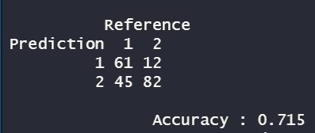
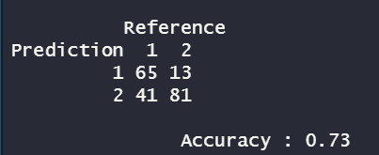
Decision Tree

Slide 13
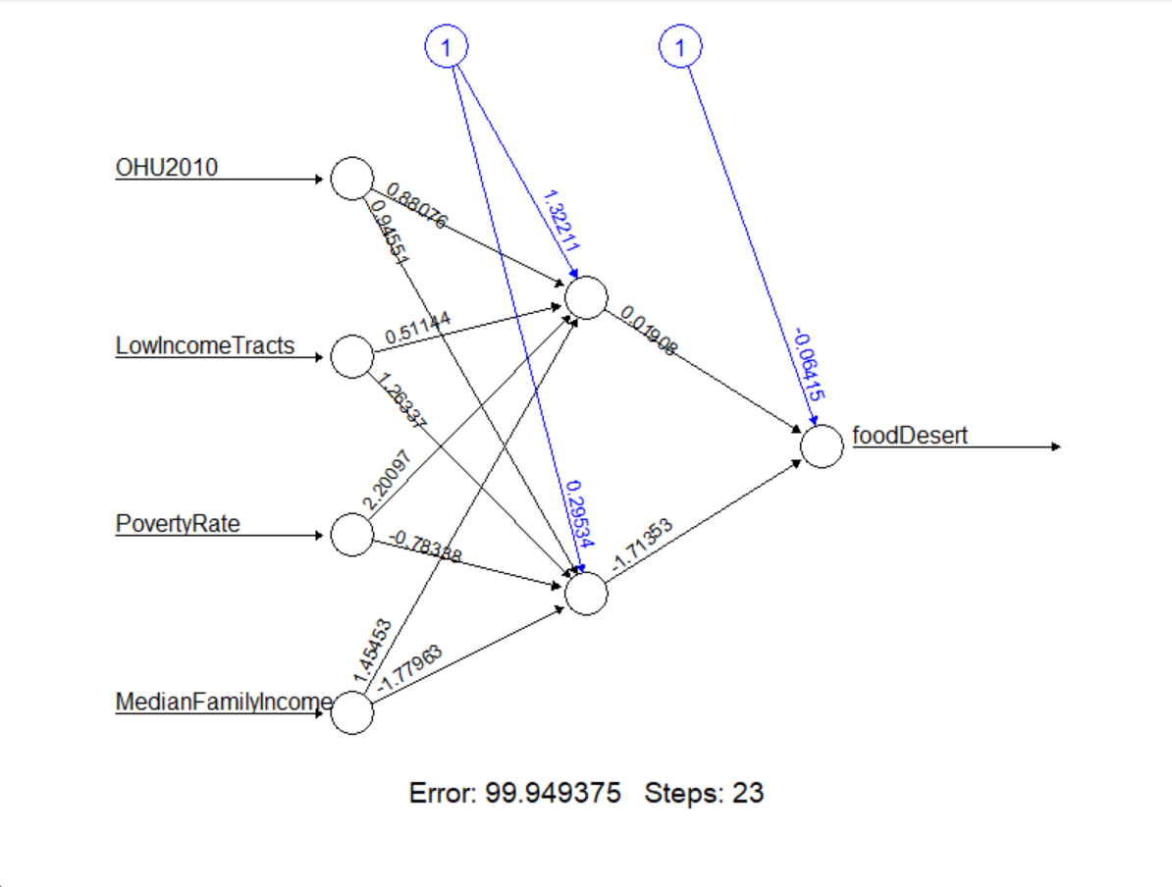
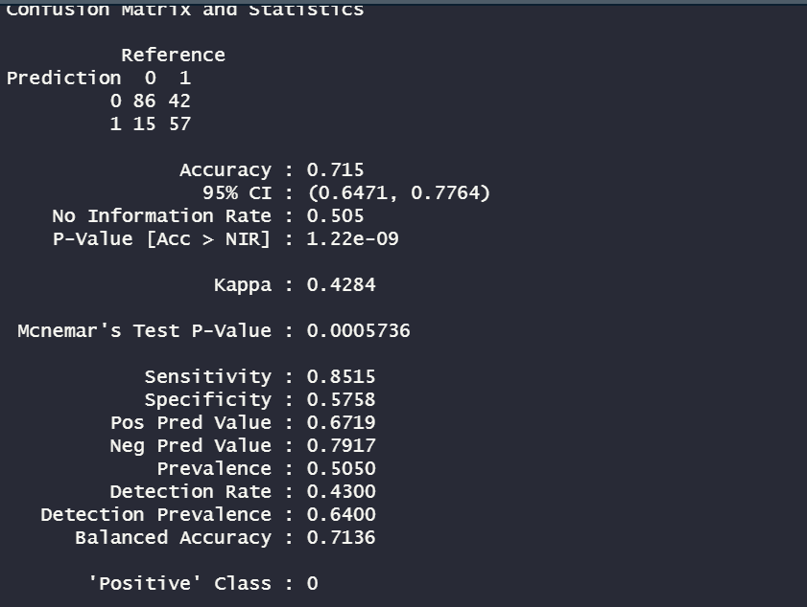
Neural Network

Slide 14
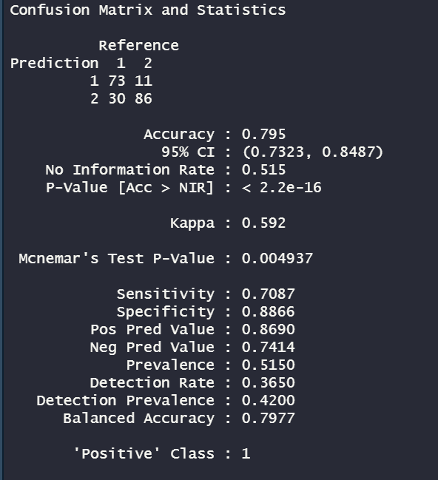
KNN
Tested k with 5, 10, 15, and 25-30
28 had the best accuracy

Slide 15
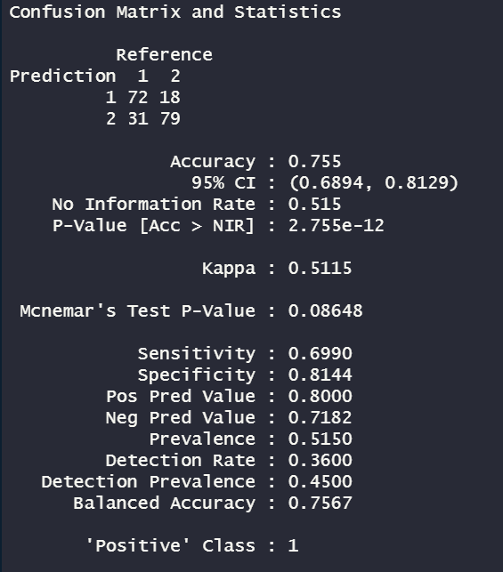
Random Forest
Food desert changed to a factor
Parameters of 300 trees generated and 2 variables per tree

Slide 16
Thank You!

